Slide 1
Enhancing copies in the Core of Relational Databases
May 17th, 2022

Slide 2
01 – Previous meeting wrap up
02 – Task completion
03 – Current status
04 – Next steps

Slide 3
01
Previous meeting wrap up

Slide 4
Previous meeting comments
Dual-pass shows a better performance than single-pass approach.
Proof of convergence for the non-weighted points.

Slide 5
03
Current status

Slide 6
Current Status
01
Validate copy process with weights and with new datasets
02
Adapting mathematical framework for weighted data

Slide 7
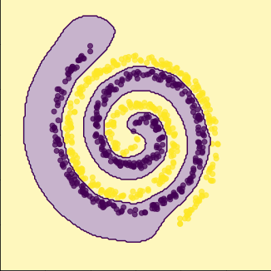
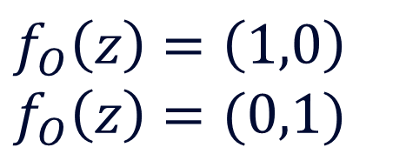
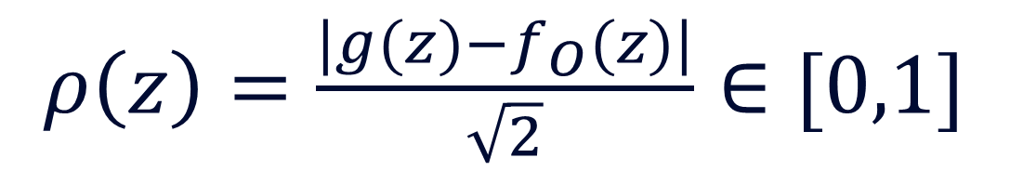
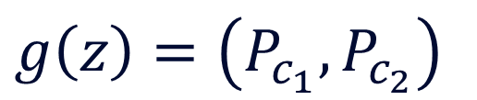
Introducing weighted points
At each step and for each point we define a $ρ\left(z\right)$ that give us an idea of the confidence that our model has in the classification of the point $z$.
Spirals dataset:
Binary classification:
$$f_{O}\left(z\right)=\left(1,0\right) \\ f_{O}\left(z\right)=(0,1)$$
Original model (Oracle)
Completely separable
$ρ\left(z\right)=\frac{|g(z)−f_{O}(z)|}{\sqrt{2}}∈[0,1]$
$$g\left(z\right)=\left(P_{c_{1}},P_{c_{2}}\right)$$
Copy model
$ρ\left(z\right)=0.$ Total confidence in the classification of the point $z$.
$ρ(z)=1$. Worse scenario: error + total confidence.
Asumtion: the model compress the information in the parameters and only points with large $ρ\left(z\right)$ contribute during the training

Slide 8
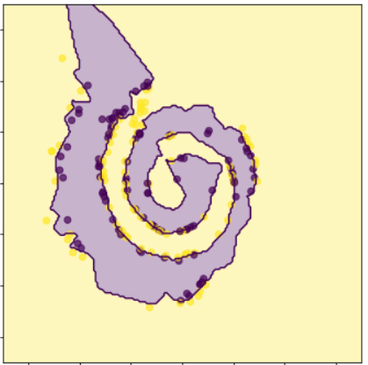
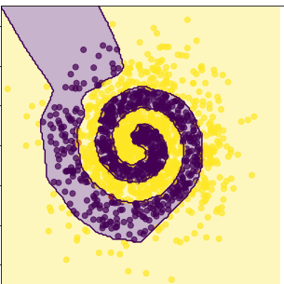
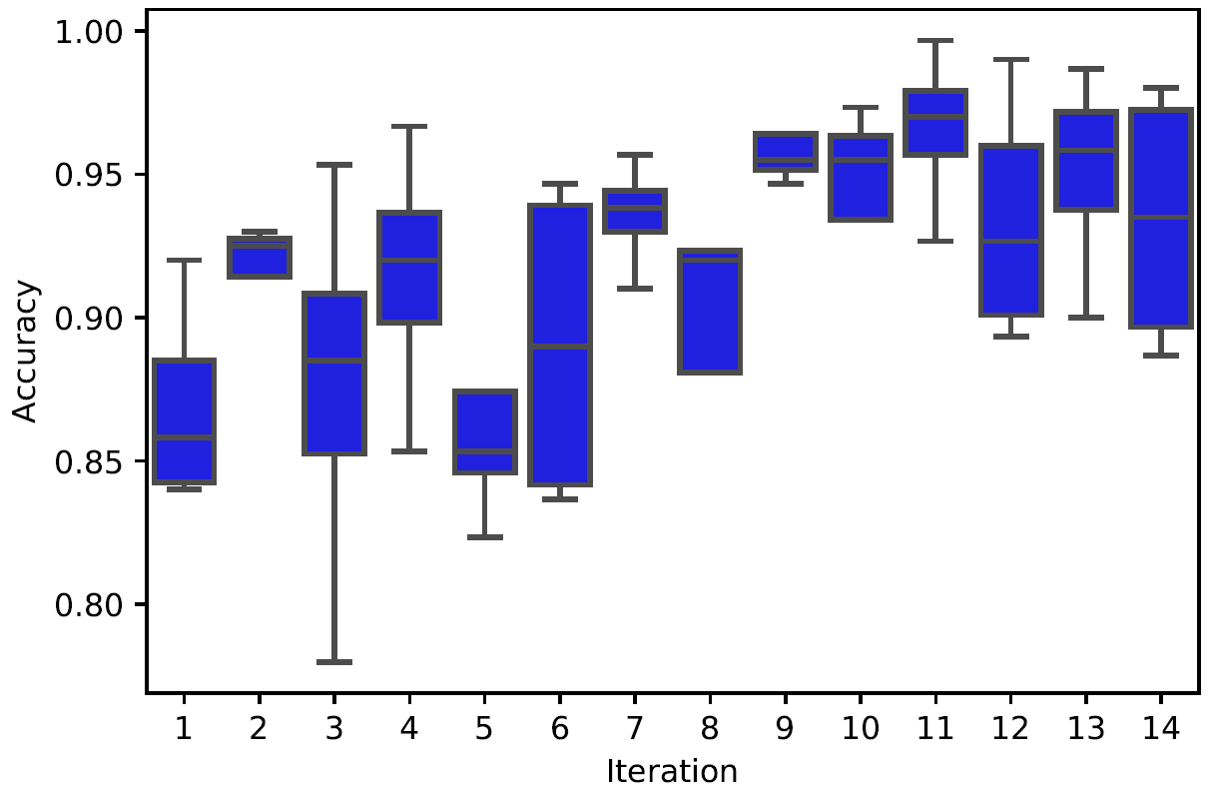
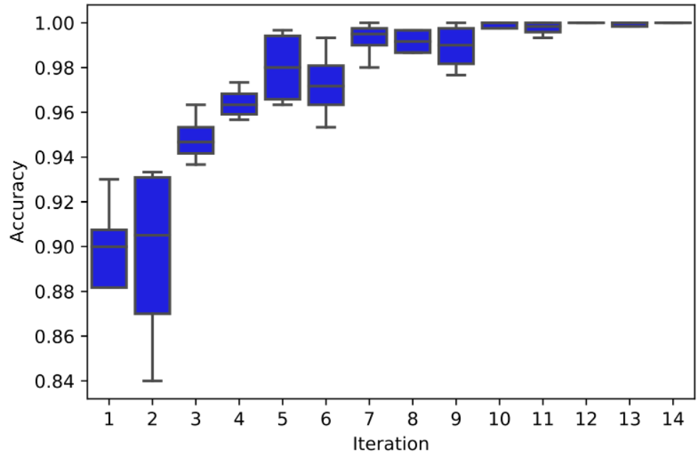
Results:
Original model:
Dual pass <200 (per iteration)
Single pass + 200 at each iteration
Single pass

Slide 9
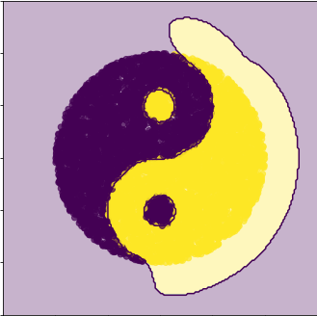
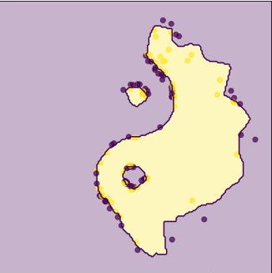
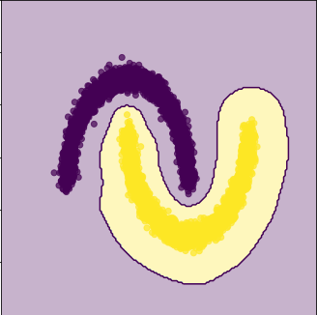
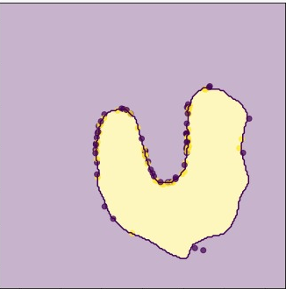
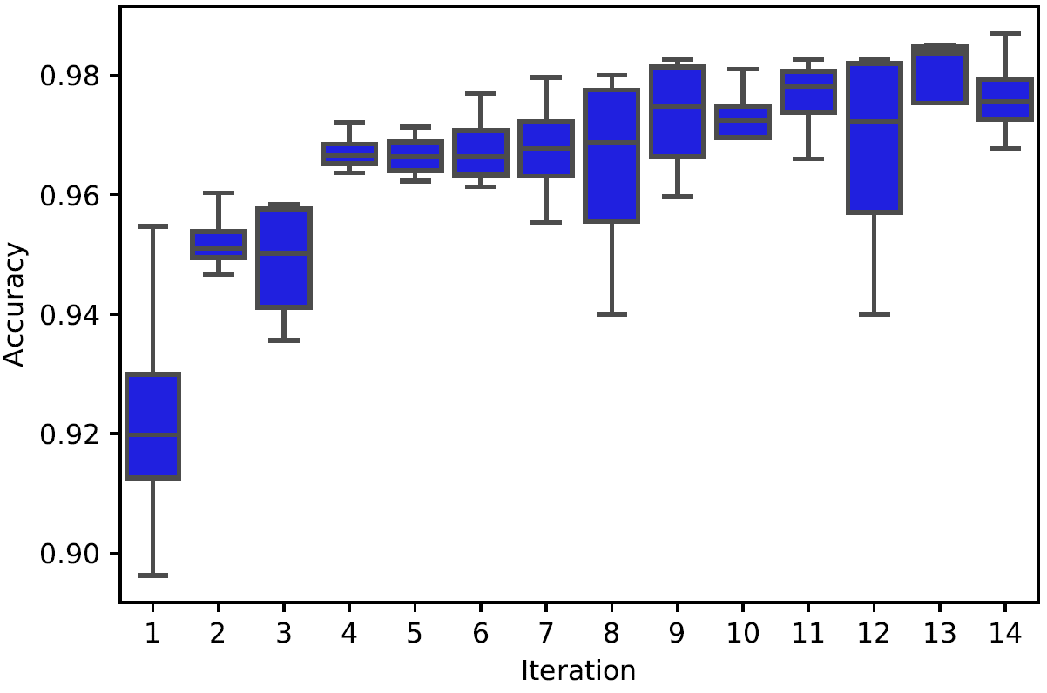
Other datasets:
Yin-yang dataset: (<150) points
Moons dataset: (<100 points)

Slide 10
Current Status
01
Improving the mathematical foundation of the problem
02
Adapting mathematical framework for weighted data

Slide 11
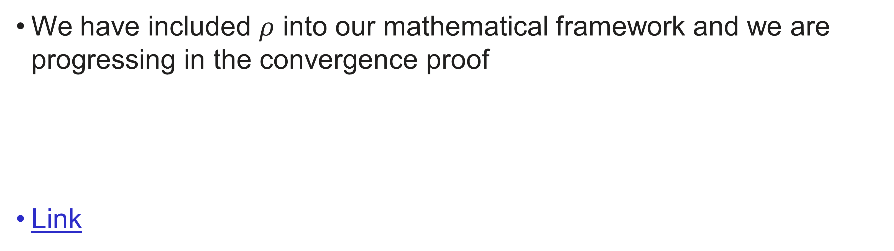
Mathematical framework
We have included $ρ$ into our mathematical framework and we are progressing in the convergence proof
Link

Slide 12
04
Next Steps

Slide 13
Next Steps
01
Validate copy process with weighted data on UCI datasets
02
Prove convergence of the dual process for the most general case
03
Present a draft + report by the end of the month (May)

